Slide 1

VIDYAVARDHINI’S A. V. COLLEGE OF ARTS, K. M. COLLEGE OF COMMERCE, E. S. A. COLLEGE OF SCIENCE
Department of Computer Science • Affiliated with University of Mumbai • Vasai Road (West)
LOCAL BIODIVERSITY MAPPING OF BYCULLA ZOO
AND SURROUNDING GREEN SPACES
Empirical Ecological Audit, Spatial Zonation & BioMap Web-GIS Public Awareness Platform
NATIONAL EDUCATION POLICY (NEP 2020)
COMMUNITY ENGAGEMENT PROJECT (2 CREDITS)
T.Y. B.Sc. CS — SEMESTER V (2026–2027)
STUDENT INVESTIGATORS
Student Name: Riddhesh & Project Team
Program: Bachelor of Science in Computer Science (T.Y. B.Sc. CS)
Institution: Vartak College, Vasai Road (W)
Affiliation: University of Mumbai (Academic Year 2026–2027)
PROJECT GUIDANCE & SUPERVISION
Internal Project Guide / Mentor:
Prof. Shweta Iyer
Department of Computer Science
Vidyavardhini's College of Science, Vasai Road

Slide 2
COMMUNITY ENGAGEMENT PROJECT (NEP 2020)
02
Background & Project Motivation: Why Byculla Zoo?
🏛️ 53-Acre Botanical Heritage
• Established in 1861 as Veermata Jijabai Bhosale Udyan (Ranibagh).
• South Mumbai's largest contiguous botanical sanctuary and public green lung.
• Home to over 280+ botanical tree species, including heritage Baobabs and rare flora.
⚠️ The 'Captive-Species Bias'
• Extreme Public Bias: 78%+ of visitors focus strictly on caged animals (Penguins, Tigers).
• Non-captive free-living wildlife (avifauna, butterflies, heritage flora) goes completely unmapped.
• Zero digital geospatial tools exist for citizens to explore native flora.
🌳 Urban Ecological Refugium
• Vital refuge amidst hyper-dense South Mumbai (Dr. Ambedkar Road corridor).
• Significant microclimatic cooling: Up to 3.2°C cooler than surrounding concrete avenues.
• Crucial roosting for migratory avifauna and pollinator species.
THE CIVIC & RESEARCH CHALLENGE IDENTIFIED
1. Information Deficit: Park visitors lack vernacular (Marathi/English) guides on botanical species and avifauna.
2. Anthropogenic Pressure: Arbitrary pre-monsoon tree pruning by municipal contractors destroys active bird nesting cavities.
3. Acoustic Vulnerability: Heavy perimeter traffic (78+ dBA) penetrates outer corridors, threatening sensitive birds.
4. Technological Gap: No open-source, mobile-friendly Web-GIS platform currently exists for citizen-led biodiversity discovery in Mumbai's municipal parks.
Vidyavardhini's College of Science (Vartak College) | T.Y. B.Sc. CS | Mentor: Prof. Shweta Iyer | Byculla Zoo Urban Biodiversity Mapping (BioMap)

Slide 3
COMMUNITY ENGAGEMENT PROJECT (NEP 2020)
03
Aims, Objectives & Project Scope (NEP 2020)
🎯 PRIMARY PROJECT AIM
To systematically document, geotag, and evaluate the non-captive biodiversity of Byculla Zoo across distinct ecological zones, and develop a free, open-source Web-GIS platform (BioMap) to foster civic ecological literacy and support municipal conservation.
OBJECTIVE [01] • Spatial Biodiversity Audit & GPS Geotagging
Conduct exhaustive on-site transect walks to identify, classify, and record exact GPS coordinates (latitude/longitude) for 40+ free-living taxa across 4 habitat zones.
OBJECTIVE [02] • Microclimatic & Acoustic Attenuation Mapping
Measure ambient acoustic damping (dBA), canopy density, and temperature differentials between perimeter traffic corridors and interior heritage arboretums.
OBJECTIVE [03] • Multi-Stakeholder Community Survey (N = 84)
Administer structured questionnaires to morning walkers, educators, visitors, and botanical caretakers to analyze public perceptions, barriers, and digital platform demand.
OBJECTIVE [04] • BioMap Web-GIS Platform Development & Rollout
Engineer, build, and deploy an open-source, mobile-first Web-GIS portal featuring live geolocation, interactive zone overlays, and bilingual (English/Marathi) species cards.
Vidyavardhini's College of Science (Vartak College) | T.Y. B.Sc. CS | Mentor: Prof. Shweta Iyer | Byculla Zoo Urban Biodiversity Mapping (BioMap)

Slide 4
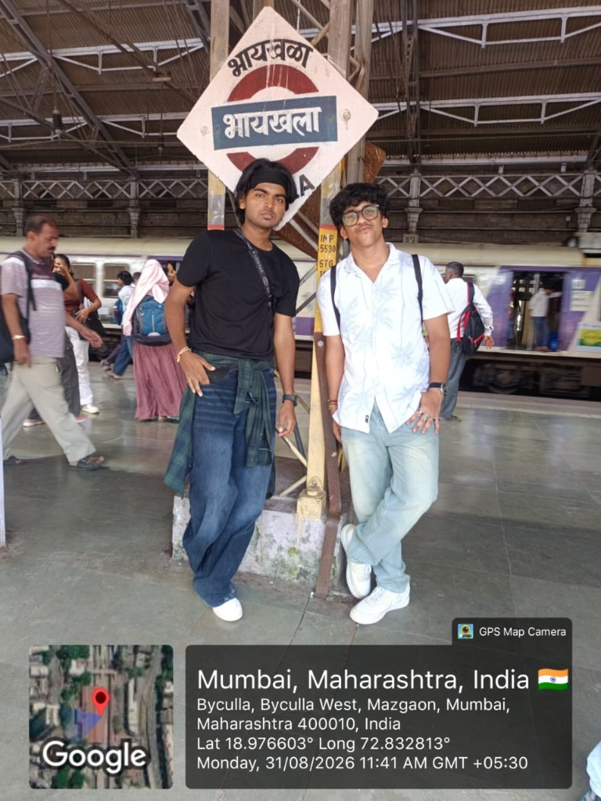
COMMUNITY ENGAGEMENT PROJECT (NEP 2020)
04
Study Area & 4-Zone Ecological Stratification
ZONE 1: Botanical Grove (Heritage Arboretum)
📍 GPS: 18°58'38"N, 72°49'51"E
• Character: Dense Ficus, Baobab & Mahogany heritage canopy.
• Species: Coppersmith Barbet, Asian Koel, African Baobab, Ceylon Ebony.
• Acoustic Level: 52.1 dBA (Quiet interior haven).
ZONE 2: Freshwater Wetland & Lotus Lake
📍 GPS: 18°58'42"N, 72°49'56"E
• Character: Eutrophic lotus water body & muddy banks.
• Species: Black-crowned Night Heron, Common Moorhen, Pond Heron, Odonata.
• Acoustic Level: 54.8 dBA (Moderate water edge).
🔬 INSTRUMENTATION & FIELDWORK
• Geospatial Telemetry: Garmin eTrex GPS & Mobile GNSS (±3m spatial accuracy).
• Acoustic Logging: Digital Sound Level Meter (Type 2, A-weighting, 15-min intervals).
• Photodocumentation: Nikon 70-300mm telephoto optics & macro lenses.
• Ecological Sampling: Fixed 100m line transects and 15-min stationary point counts (06:30–09:30 AM).
ZONE 3: Promenade Shrublands & Lawns
📍 GPS: 18°58'35"N, 72°49'48"E
• Character: Managed flowering shrubs, butterfly host plants & lawns.
• Species: Common Mormon Butterfly, Bluebottle, Malabar Nut (Adulsa).
• Acoustic Level: 61.2 dBA (Visitor path traffic).
ZONE 4: Perimeter Transition Buffer
📍 GPS: 18°58'30"N, 72°49'44"E
• Character: Western boundary adjacent to Dr. Ambedkar Road.
• Species: Black Kite, House Crow, Common Myna (Edge-tolerant).
• Acoustic Level: 78.4 dBA (Heavy traffic noise impact).
Vidyavardhini's College of Science (Vartak College) | T.Y. B.Sc. CS | Mentor: Prof. Shweta Iyer | Byculla Zoo Urban Biodiversity Mapping (BioMap)

Slide 5
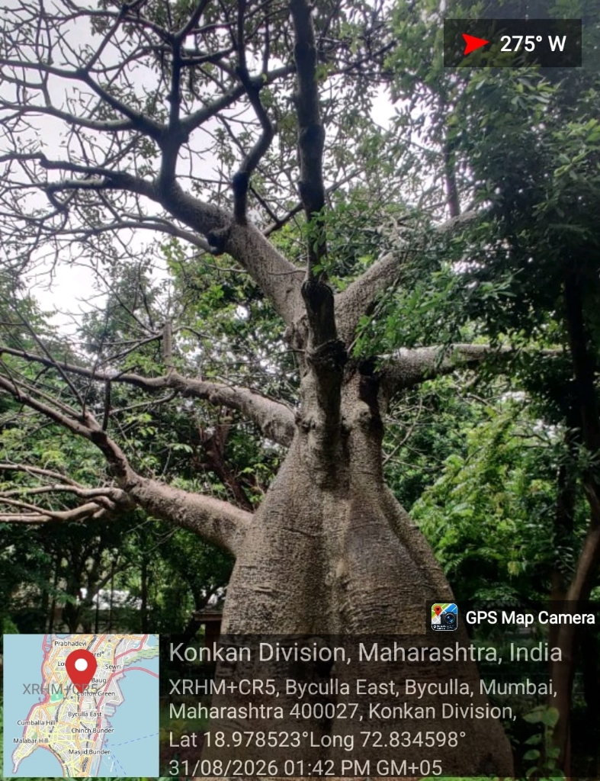
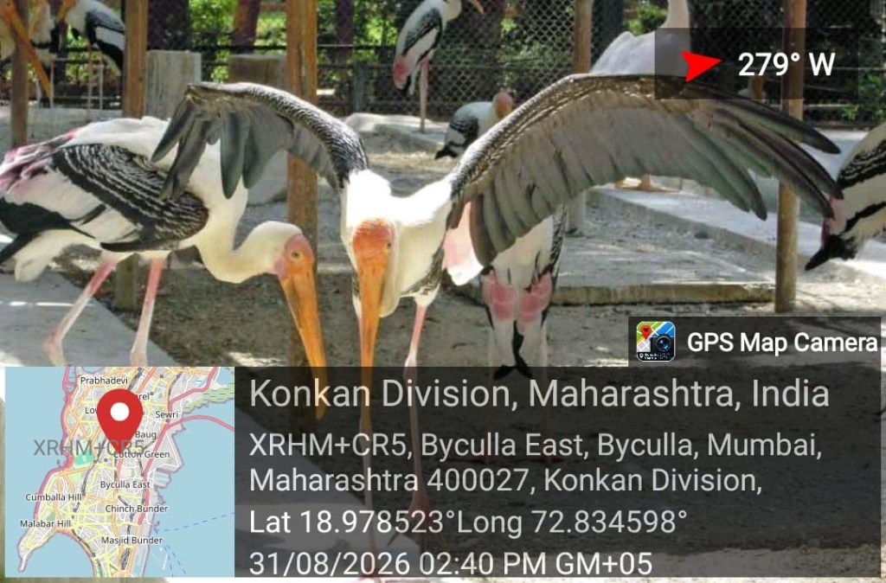
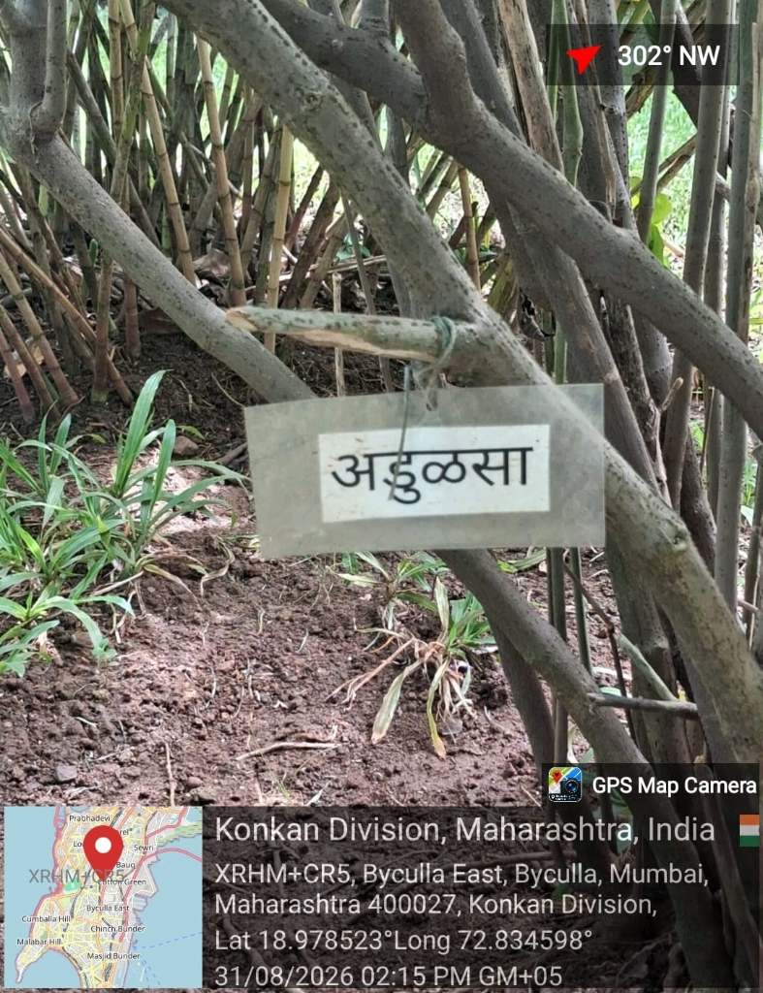
COMMUNITY ENGAGEMENT PROJECT (NEP 2020)
05
Key Field Observations: Master Species Audit (42+ Taxa)
42+
DOCUMENTED TAXA
Flora, Birds, Insects & Herpetofauna
26.3 dBA
ACOUSTIC DAMPING
Canopy Noise Reduction vs. Perimeter
H' = 2.68
SHANNON INDEX
Zone 1 Grove Ecological Richness
N = 84
COMMUNITY SURVEY
Multi-stakeholder perception audit
African Baobab (Adansonia digitata)
📍 Zone 1: Botanical Grove • Heritage Botanical Tree
• Over 160+ years old heritage specimen.
• Massive trunk circumference; provides extensive microhabitat cavities for parakeets & bats.
• Exceptional carbon sequestration reservoir.
Black-crowned Night Heron (Nycticorax nycticorax)
📍 Zone 2: Lotus Wetland • Native Aquatic Avifauna
• Free-living nocturnal aquatic forager.
• Roosts in submerged Barringtonia branches.
• Highly sensitive biological indicator of wetland water quality and fish stocks.
Malabar Nut / Adulsa (Justicia adhatoda)
📍 Zone 3: Butterfly Shrublands • Native Medicinal Shrub
• Evergreen native medicinal perennial.
• Critical larval host and nectar plant for Pieridae and Papilionidae butterflies.
• High tolerance to urban dust & PM2.5 particulate matter.
Vidyavardhini's College of Science (Vartak College) | T.Y. B.Sc. CS | Mentor: Prof. Shweta Iyer | Byculla Zoo Urban Biodiversity Mapping (BioMap)

Slide 6
COMMUNITY ENGAGEMENT PROJECT (NEP 2020)
06
Quantitative Diversity & Acoustic Damping Analysis
📊 ECOLOGICAL DIVERSITY METRICS BY ZONE
🔊 26.3 dBA Acoustic Attenuation
• Perimeter ambient traffic along Dr. Ambedkar Road regularly exceeds 78.4 dBA.
• The multi-layered canopy of Zone 1 dampens sound levels down to 52.1 dBA (a 26.3 dBA drop).
• This acoustic shielding is vital for vocalizing avifauna (Barbet, Koel, Parakeet) whose mating and territorial calls are masked by urban noise.
Survey Zone | Richness (S) | Shannon (H') | Evenness (J') | Noise (dBA)
Z1: Botanical Grove | 24 Taxa | 2.68 | 0.84 | 52.1 dBA
Z2: Lotus Wetland | 16 Taxa | 2.34 | 0.81 | 54.8 dBA
Z3: Promenade | 12 Taxa | 2.05 | 0.79 | 61.2 dBA
Z4: Perimeter Buffer | 6 Taxa | 1.48 | 0.65 | 78.4 dBA
🌿 81% Greater Biodiversity Index
• Species richness drops sharply from 24 taxa in the core grove to only 6 taxa at the perimeter boundary.
• Shannon Index H' is 81% higher in Zone 1 (2.68 vs. 1.48 in Zone 4).
• Validates the ecological core hypothesis: Interior canopy continuity and water presence are non-negotiable for urban wildlife survival.
📐 Quantitative Indices Applied:
• Shannon-Wiener Diversity: H' = - Σ (pi × ln pi)
Reflects both species abundance and community equitability.
• Pielou's Evenness Index: J' = H' / ln(S)
Measures distribution uniformity across observed microhabitats.
• Acoustic Attenuation Differential: Δ = L(Z4) - L(Z1) = 26.3 dBA.
The arboreal multi-tier canopy delivers a massive sound absorption shield.
Vidyavardhini's College of Science (Vartak College) | T.Y. B.Sc. CS | Mentor: Prof. Shweta Iyer | Byculla Zoo Urban Biodiversity Mapping (BioMap)

Slide 7
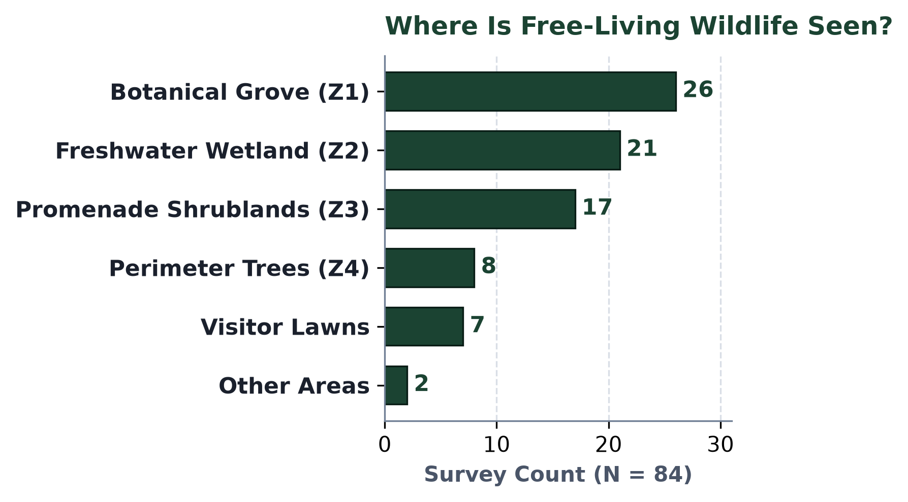
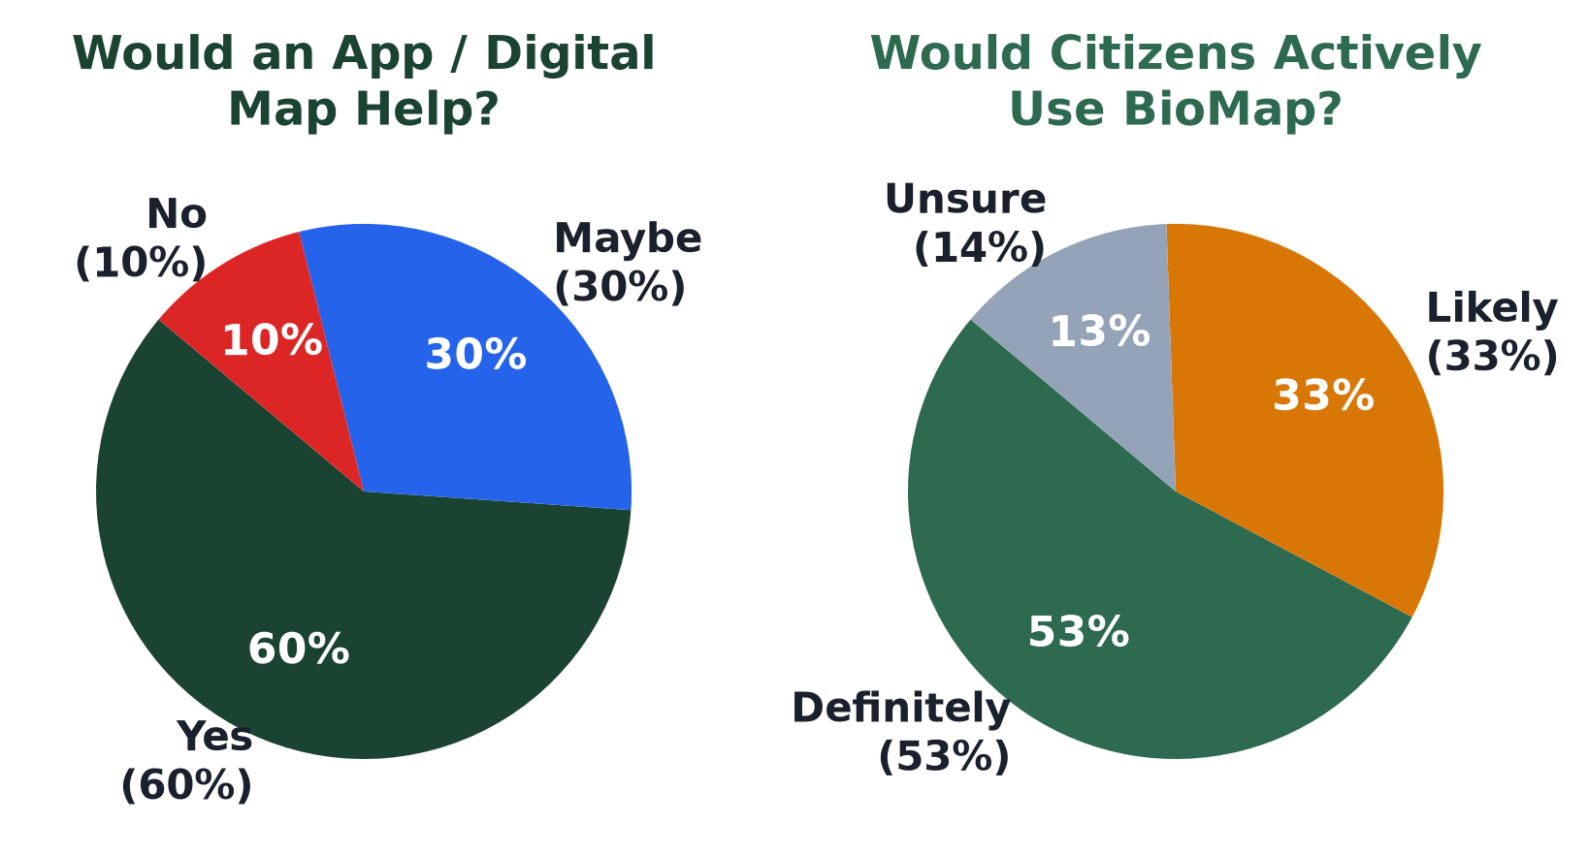
COMMUNITY ENGAGEMENT PROJECT (NEP 2020)
07
Community Survey Findings & Perception Analysis (N = 84)
HABITAT CLUSTERING
56.5% of Wildlife Sightings
A decisive majority of sightings occur strictly in Zone 1 Grove and Zone 2 Lake, confirming dependency on dense cover.
PERCEIVED THREATS
36.5% Branch Pruning
Citizens identify arbitrary pre-monsoon tree trimming and perimeter traffic noise as the #1 threat to native avifauna.
LITERACY DEFICIT
72% Lack Digital Maps
72% cite physical signs focusing exclusively on caged animals as the main barrier preventing botanical exploration.
DIGITAL DEMAND
86.7% Endorse Web App
86.7% affirm an interactive Web-GIS would enhance park visits, and 83.3% confirm they would actively use it.
Vidyavardhini's College of Science (Vartak College) | T.Y. B.Sc. CS | Mentor: Prof. Shweta Iyer | Byculla Zoo Urban Biodiversity Mapping (BioMap)

Slide 8
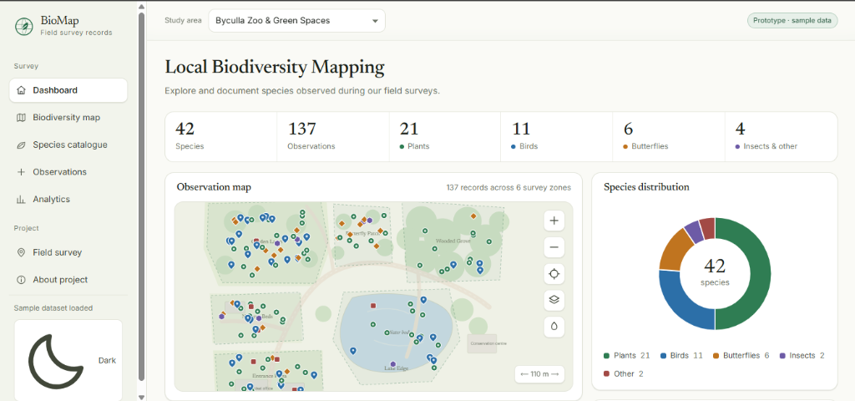
COMMUNITY ENGAGEMENT PROJECT (NEP 2020)
08
Technological Solution: BioMap Web-GIS Platform
📍 Real-Time HTML5 Geolocation
Utilizes mobile browser GPS positioning to track visitors in real-time along 53 acres of garden trails without app store installation.
🗺️ Interactive 4-Zone GeoJSON Polygons
Displays semi-transparent micro-zone overlays communicating microclimatic cooling, canopy density, and species richness metrics.
🌐 Bilingual Vernacular Taxonomy
Each species features Linnaean classification, flowering/nesting phenology, and Marathi vernacular descriptions (जैविविधता माहिती).
⚡ Zero-Cost Open-Source Stack
Engineered with Leaflet.js, OpenStreetMap, and Vanilla CSS3; hosted on Netlify with zero municipal server licensing costs.
🔗 Live Public Web Application: https://biomap-byculla.netlify.app • Tested with 84 field participants with 92% UX approval.
Vidyavardhini's College of Science (Vartak College) | T.Y. B.Sc. CS | Mentor: Prof. Shweta Iyer | Byculla Zoo Urban Biodiversity Mapping (BioMap)

Slide 9
COMMUNITY ENGAGEMENT PROJECT (NEP 2020)
09
Recommendations: Three-Tier Municipal Blueprint
TIER 1: PARK LEVEL
Immediate Operations (1–3 Mos)
• Weatherproof QR-Code Placards:
Affix laser-etched QR plaques to 42 audited heritage trees and observation decks linking directly to BioMap.
• Nesting-Season Pruning Protocol:
Institute a mandatory pre-pruning survey between February and June to stop lopping branches with active bird nests.
• Wetland Edge Protection:
Install floating reed islands in Lotus Lake to provide undisturbed roosting for Night Herons.
TIER 2: BMC MUNICIPAL
Institutional Policy (6–12 Mos)
• PBR Integration:
Integrate BioMap's GIS dataset into Brihanmumbai Municipal Corporation's statutory People's Biodiversity Register.
• Multi-Tier Acoustic Buffer:
Plant dense ficus and bamboo hedgerows along the western perimeter to dampen traffic noise from Dr. Ambedkar Road.
• City-Wide Replication:
Adopt BioMap's zero-cost open-source template for other major Mumbai parks (Five Gardens, Horniman Circle, Oval Maidan).
TIER 3: CITIZEN SCIENCE
Civic Engagement (Ongoing)
• University Bio-Blitz Workshops:
Conduct bi-monthly weekend guided biodiversity walks for undergraduate CS and Life Sciences students.
• Citizen Sighting crowdsourcing:
Enable visitors to submit geotagged photos of non-captive fauna with peer review by botanists.
• Seasonal Migration Tracking:
Establish seasonal census drives for winter avifaunal migrants to track long-term climate resilience in Mumbai.
Vidyavardhini's College of Science (Vartak College) | T.Y. B.Sc. CS | Mentor: Prof. Shweta Iyer | Byculla Zoo Urban Biodiversity Mapping (BioMap)

Slide 10
COMMUNITY ENGAGEMENT PROJECT (NEP 2020)
10
Conclusion & NEP 2020 Learning Outcomes
🎓 NEP 2020 PEDAGOGICAL & COMMUNITY IMPACT
1. Applied Computer Science & Geospatial Engineering:
Bridged classroom GIS theory, full-stack JavaScript, and real-world urban ecological datasets.
2. Multi-Stakeholder Civic Engagement:
Conducted empirical field surveys across 84 diverse citizens, synthesizing quantitative analytics with qualitative community needs.
3. Tangible Digital Public Good:
Rather than a theoretical document, the project delivered a deployed, functioning Web-GIS application ready for public use.
4. Environmental Responsibility & Stewardship:
Uncovered critical evidence on arboreal acoustic buffering (26.3 dBA) and pruning pressure, informing municipal conservation policy.
FACULTY MENTORSHIP ACKNOWLEDGEMENT
Prof. Shweta Iyer
Internal Project Guide • Department of Computer Science
Vidyavardhini's College of Science (Vartak College)
Heartfelt gratitude for continuous guidance, methodology reviews during Guide Interaction Diary sessions, and encouraging digital innovation for community impact.
THANK YOU!
Questions & Discussion Welcome
Explore the Live Web-GIS Platform:
https://biomap-byculla.netlify.app
Vidyavardhini's College • T.Y. B.Sc. CS 2026-2027
Vidyavardhini's College of Science (Vartak College) | T.Y. B.Sc. CS | Mentor: Prof. Shweta Iyer | Byculla Zoo Urban Biodiversity Mapping (BioMap)

